Slide 1
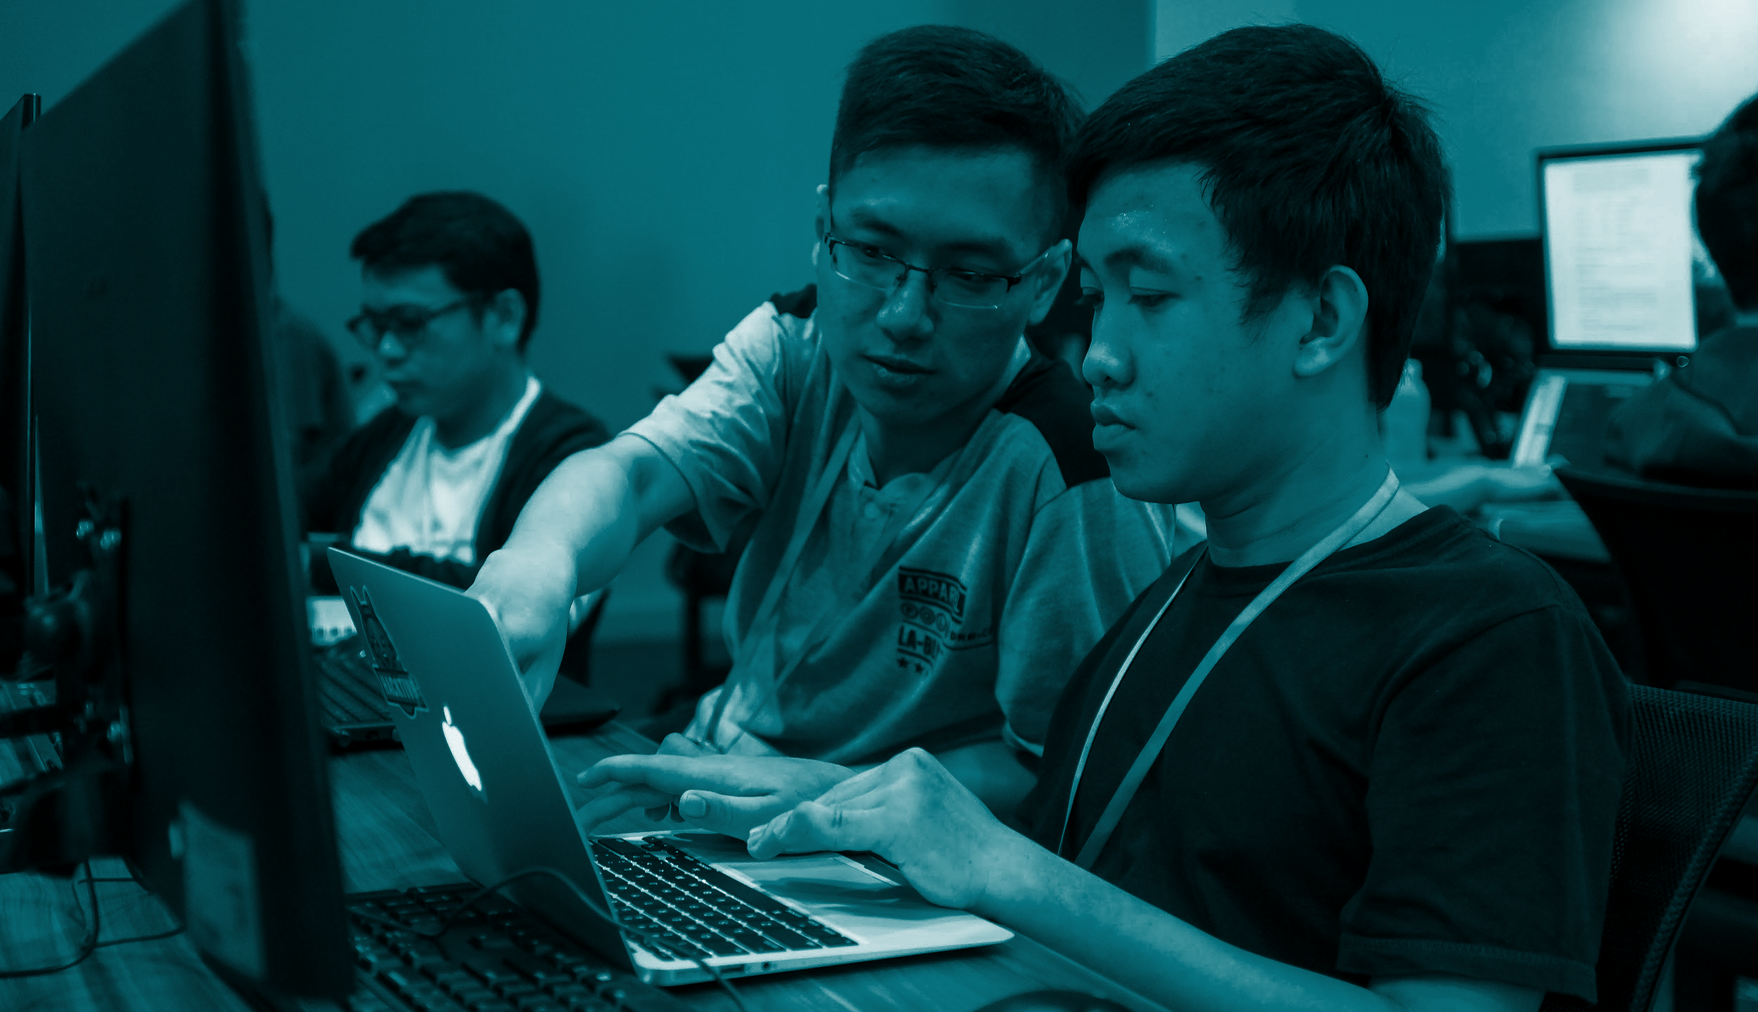
WEEK TWO - B
STRING, LOOPS & FUNCTIONS

Slide 2
STRING

Slide 3
Understanding
String
‘This is a String!’
String is a “set” of characters!
[0] => ‘T’ [1] => ‘h’ [2] => ‘i’ [3] => ‘s’
[4] => ‘ ’ [5] => ‘i’ …

Slide 4
LOOPS

Slide 5
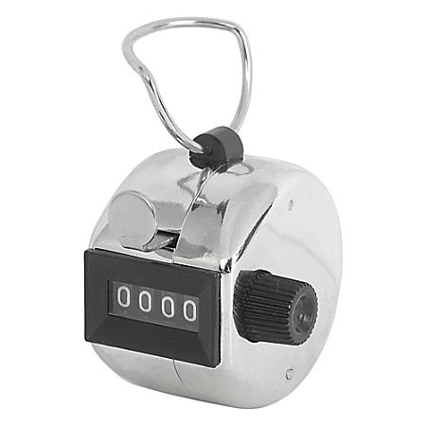
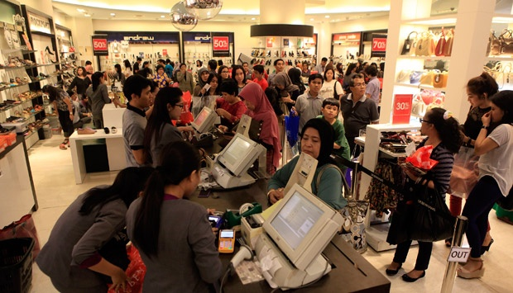
Writing JavaScript
Looping
Let’s do a midnight sale for the first 100 person!

Slide 6

Writing JavaScript
Looping
I’ll count from person number 1
until person number 100!

Slide 7

Writing JavaScript
Looping
LET’S RECITE THE PROCESS
One by one!

Slide 8
Writing JavaScript
Looping
INITIALIZATION
Start the transactions from 0, serving our first customer!

Slide 9
Writing JavaScript
Looping
LIMIT
Do and repeat the transactions until reach 100th person. Then, stop the cashier. The sale has ended!

Slide 10
Writing JavaScript
Looping
The real transaction process belongs here...

Slide 11
Writing JavaScript
Looping
EXPRESSION
Serve each customer nicely :)
Then, tick the counter to
add 1 to the counter.
Here, we do something to increase the counter.

Slide 12
Writing JavaScript
Looping
LET’S DO IT ONCE AGAIN!
But now in JavaScript

Slide 13
Writing JavaScript
Looping
INITIALIZATION
var counter = 0
Start by declaring a counter variable, then assign it with zero.

Slide 14
Writing JavaScript
Looping
EXPRESSION
counter = counter + 1
Each time a transaction is done, let’s add the counter by 1.

Slide 15
Writing JavaScript
Looping
LIMIT
while(counter < 100)
As long as the number of customer still below 100, let’s repeat the process!

Slide 16
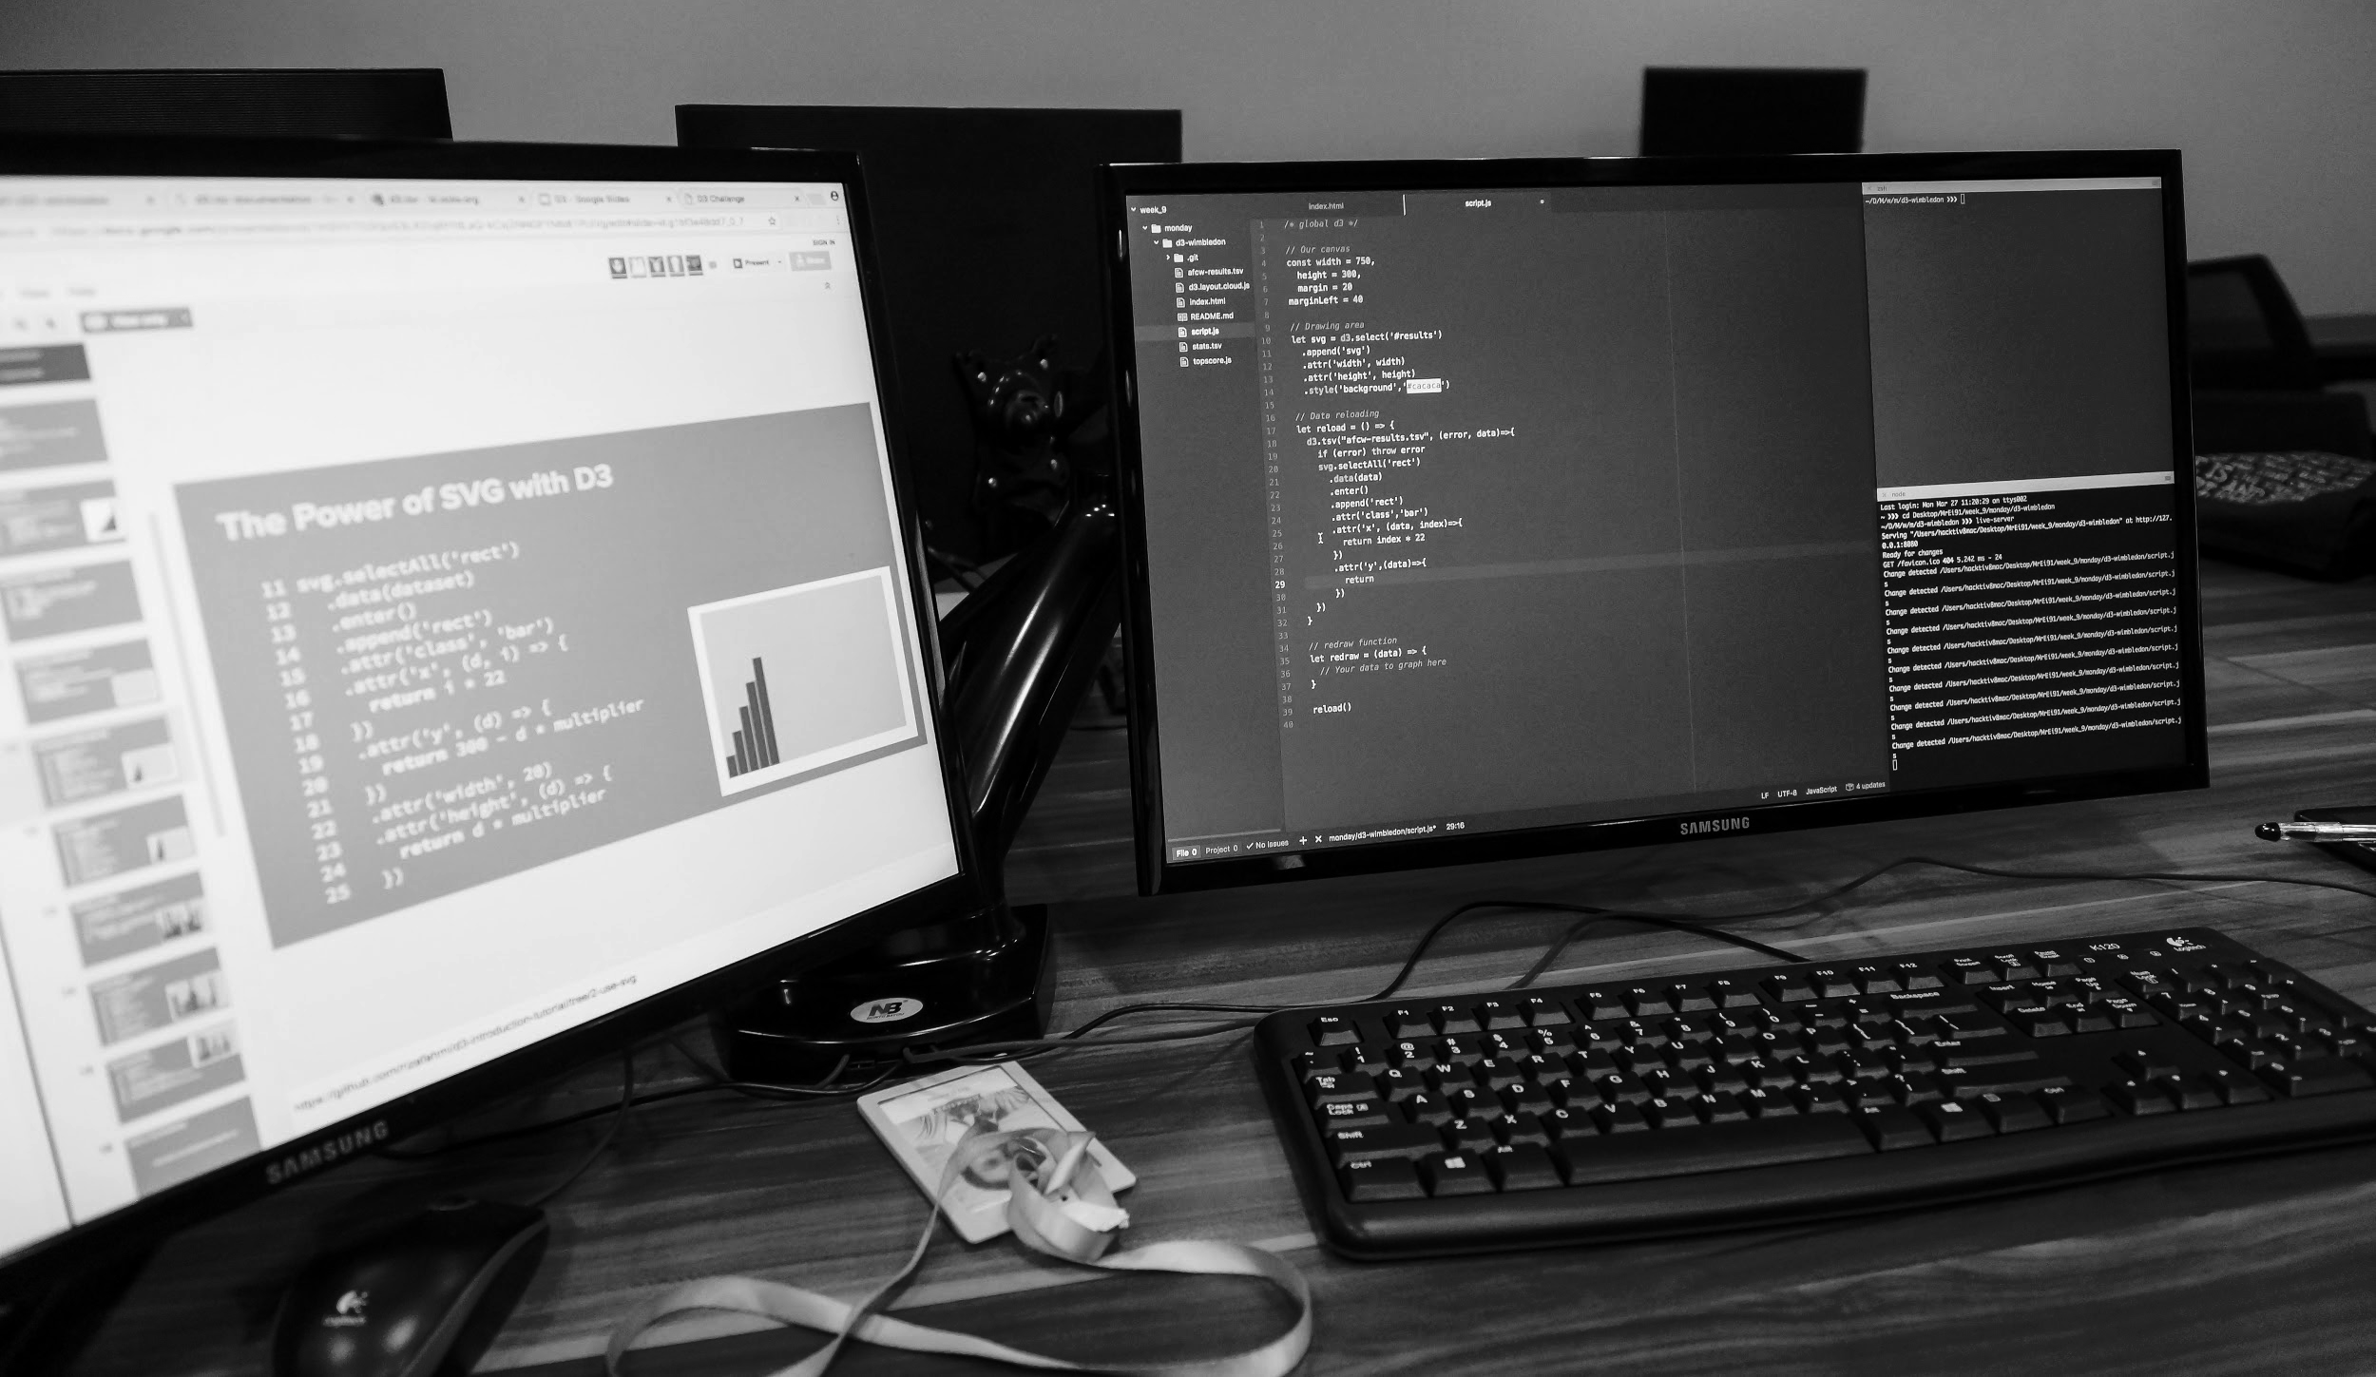
GOT SOME
QUESTIONS?

Slide 17
Writing JavaScript
Looping
WHILE
FOR (Explore on your own on Day 2, but the concept is really similar to while)

Slide 18
INTRODUCING
FUNCTIONS

Slide 19
Copying and Pasting Codes are
PAINFUL
// i need to print 5 hashes #####
var numberOfHashes = 5;
var counter = 0;
var hashes = ‘ ‘;
while(counter < numberOfHashes) {
hashes = hashes + ‘#’;
counter = counter + 1;
}
console.log(hashes);
// now i need to print 3 hashes ###
numberOfHashes = 3;
counter = 0;
Hashes = ‘ ’;
while(counter < numberOfHashes) {
hashes = hashes + ‘#’;
counter = counter + 1;
}
console.log(hashes);
// now i need to print 7 hashes ###
numberOfHashes = 7;
counter = 0;
Hashes = ‘ ’;
while(counter < numberOfHashes) {
hashes = hashes + ‘#’;
counter = counter + 1;
}
console.log(hashes);
// now i need to print 10 hashes ###
numberOfHashes = 10;
counter = 0;
Hashes = ‘ ’;
while(counter < numberOfHashes) {
hashes = hashes + ‘#’;
counter = counter + 1;
}
console.log(hashes);

Slide 20
Copying and Pasting Codes are
PAINFUL
We’re copying and pasting the same block of code 4 TIMES! That’s super-redundant!
What if we need to run this code 500 times?
Copy paste them 500 times? D:

Slide 21
Copying and Pasting Codes are
PAINFUL
PROGRAMMERS WORK HARD + SMART!
WE NEED BETTER SOLUTION!

Slide 22

Introducing
Function
Function = A section of code block that does specific task.
Example:
Buy Newspaper
Cook Instant Noodle
Go to Hacktiv8

Slide 23
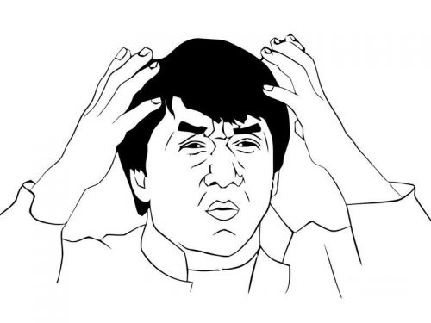
Introducing
Function
Section of code block ???

Slide 24
Introducing
Function
Function = Some lines of codes grouped together!
In human language, we can call them
“A set of instructions”
Example:
Buy Newspaper
Cook Instant Noodle
Go to Hacktiv8

Slide 25
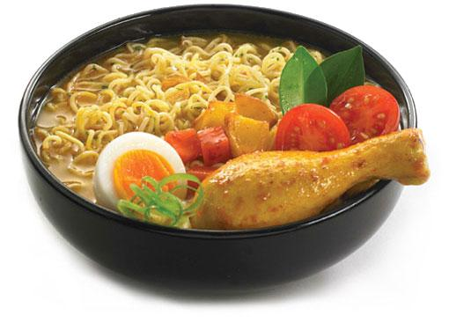
Introducing
Function
Case: Time to cook Instant Noodle!

Slide 26
Introducing
Function
Ex:
Function Cook Indomie
Grab noodle
Open the package
Boil the water
Open the seasonings
Put the instant noodle inside the boiling water
Stir the noodle with the seasonings

Slide 27
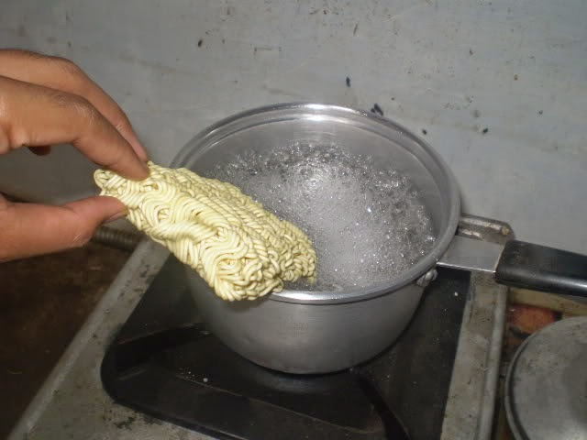
Introducing
Function
Ex:
Function Cook Indomie
Grab noodle
Open the package
Boil the water
Open the seasonings
Put the instant noodle inside the boiling water
Stir the noodle with the seasonings
PROCESS

Slide 28
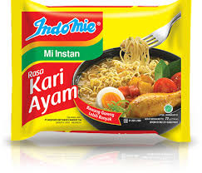
Introducing
Function
Some Function need inputs!
To cook instant noodle, we need to know the variant of the noodle.
Function: Cook Indomie
Input: variant

Slide 29
Introducing
Function
Ex:
Function Cook Indomie ( variant )
Grab noodle with variant
Open the package
Boil the water
Open the seasonings
Put the instant noodle inside the boiling water
Stir the noodle with the seasonings
PROCESS

Slide 30
Introducing
Function
Some Function need outputs!
When we’re cooking, of course we need the cooked noodle. Not just cook and toss it away!
Function: Cook Indomie
Input: variant
Output: delicious noodle

Slide 31
Introducing
Function
Ex:
Function Cook Indomie ( variant )
Grab noodle with variant
Open the package
...
Stir the noodle with the seasonings
Return delicious noodle
PROCESS

Slide 32
Introducing
Function
FUNCTION =>
Input (optional, only accept input when needed!)
Process (required)
Output (optional, only return output when needed!)

Slide 33
Introducing
Function
FUNCTION =>
INPUT
PROCESS
OUTPUT

Slide 34
WRITING
FUNCTIONS

Slide 35
Writing
Function
FUNCTION =>
Input -> Parameters
Process -> any block of code
Output -> return a data / value with any data type

Slide 36
Writing
Function
// function without input and output
function cookNoodle() {
console.log(‘just cooking here…’);
}

Slide 37
Writing
Function
// function with input and without output
function cookNoodle(variant) {
console.log(‘just cooking here…’);
}

Slide 38
Writing
Function
// function with input and output
function cookNoodle(variant) {
console.log(‘just cooking here…’);
return ‘delicious ’ + variant;
}

Slide 39
Writing
Function
We just created a function. BUT we have not call (use) it yet.
In JavaScript, to run the code inside a function, we need to call/invoke them!
We might know how to cook instant noodle, but of course we need to do it, right?

Slide 40
Writing
Function
Knowing how to cook instant noodle = Declaring a function
Do the cooking process =
Calling / Invoking a function

Slide 41
Writing
Function
Calling / Invoking a function
// without parameters
cookIndomie();
// with parameter
cookIndomie(“Kari Ayam”);

Slide 42
Writing
Function
Declaring a function
function cookIndomie(variant) {
...
}
Calling / Invoking a function
cookIndomie(“Kari Ayam”);

Slide 43
Writing
Function
Function naming tips
A good function name clearly tell us what the process just from the name.
Example
function printStars( ) { … };
function sumTwoNumbers(numOne, numTwo) { … };

Slide 44
COMING SOON
ARRAYS

Slide 45
THANK YOU AND
SEE YOU !

